Slide 1
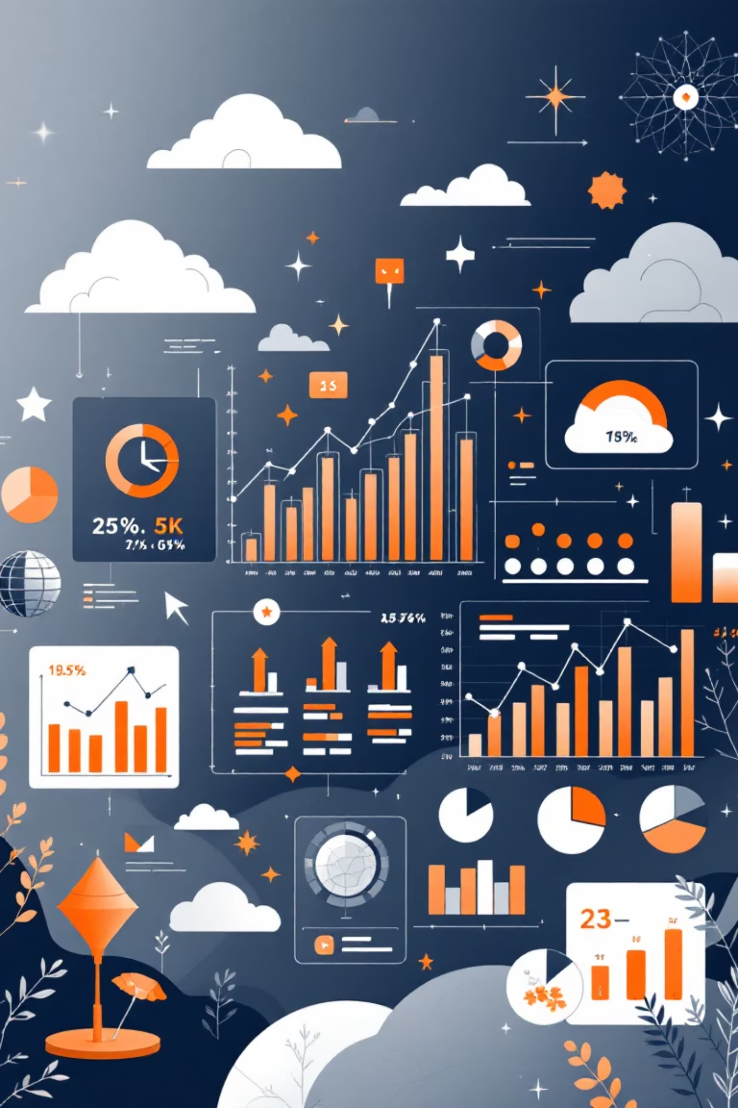
Salary Analysis Project
Analyzing employee salary data to drive informed HR and compensation decisions.

Slide 2




Project Workflow
Data Cleaning
Using Python and Pandas for data preparation.
SQL Analysis
Storing and querying data in SQL Server.
Data Visualization
Creating an interactive dashboard for insights.

Slide 3
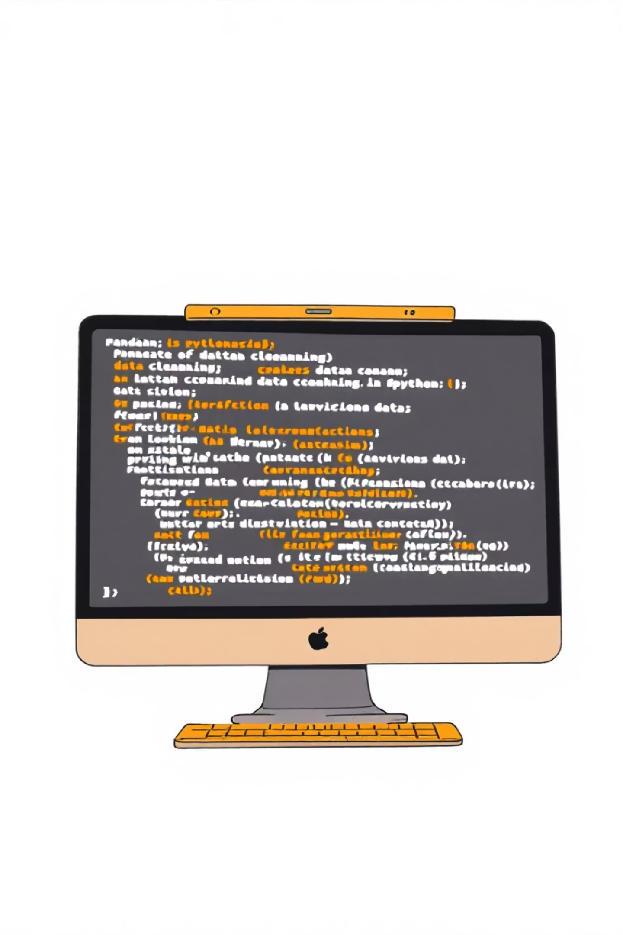
Data Cleaning with Python
The dataset was meticulously cleaned and prepared using Python's Pandas library.
Load & Explore
Standardize & Rename
Loaded dataset, explored with head(), info(), and describe().
Standardized column names to lowercase, renamed salary and bonus columns.
New Columns
Created 'total_compensation' and categorized employees by age and experience.

Slide 4





SQL Analysis: Key Business Questions
After cleaning, data was imported into SQL Server to answer critical business questions.
Top Salaries
Identified the top 10 highest-paid employees.
Job Title Averages
Calculated average salary for each job title.
Departmental Pay
Found departments with the highest average salaries.
Work Location
Compared salaries for remote vs. on-site employees.

Slide 5

SQL Analysis: Deeper Insights
Further SQL queries revealed intricate relationships within the salary data.
1
Experience & Salary
Analyzed the relationship between experience level and compensation.
2
Nationalities
Identified the highest-paying nationalities.
3
Contract Type
Determined average salary by contract type.
4
Education & Pay
Examined salary distribution based on education level.

Slide 6

SQL Analysis: Performance & Bonus
Uncovering the links between gender, performance, and bonus structures.
Gender Pay Gap
Department Performance
Hours & Bonus
Calculated average salary by gender.
Assessed average performance score by department.
Investigated the relationship between working hours and bonus.

Slide 7
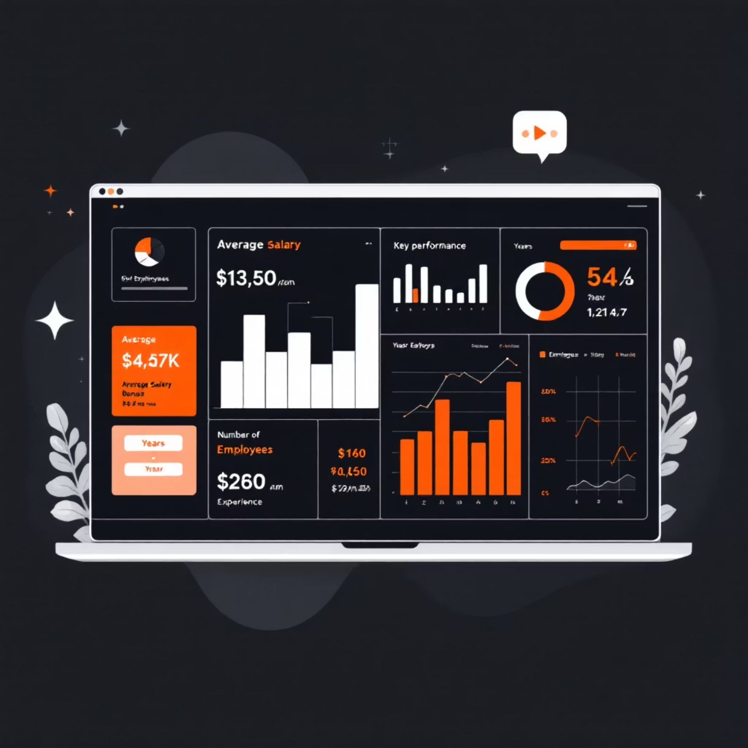
Dashboard & Insights: Overview
A comprehensive dashboard visualizes key salary trends and performance metrics.
Key Performance Indicators
Average Salary
Average Bonus
Number of Employees
Average Years of Experience
Visualizations include average salary by department and job title, employee distribution by country, and gender percentages.

Slide 8
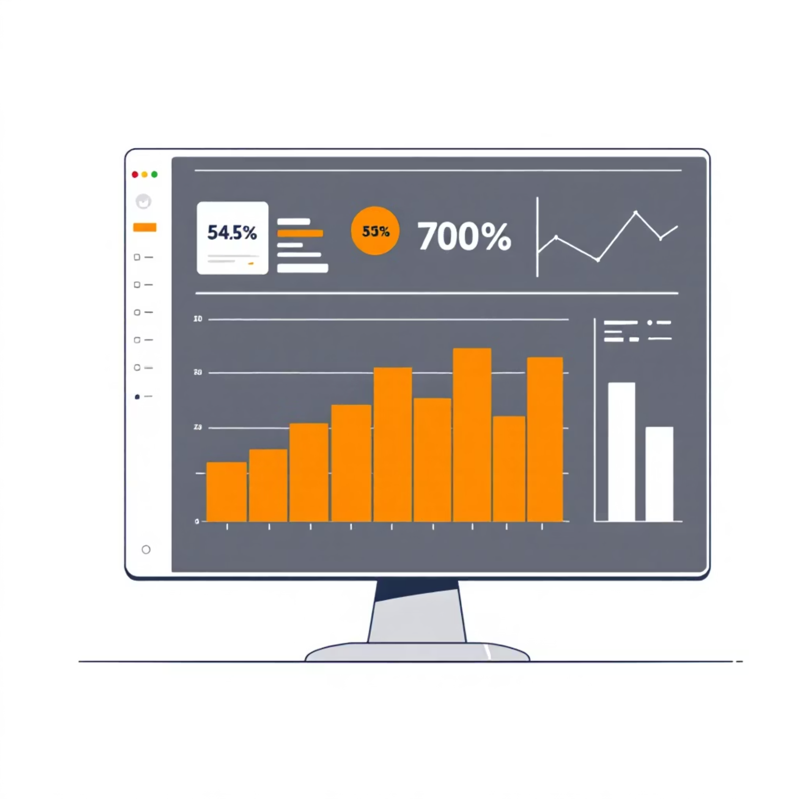
Salary & Performance Analysis
Deep dive into compensation structures and employee performance.
Visualizations
Highest-Paid Employees
Salary Distribution (Box Plot)
Average Salary by Contract Type
Salary vs. Experience/Performance (Scatter & Line Charts)

Slide 9
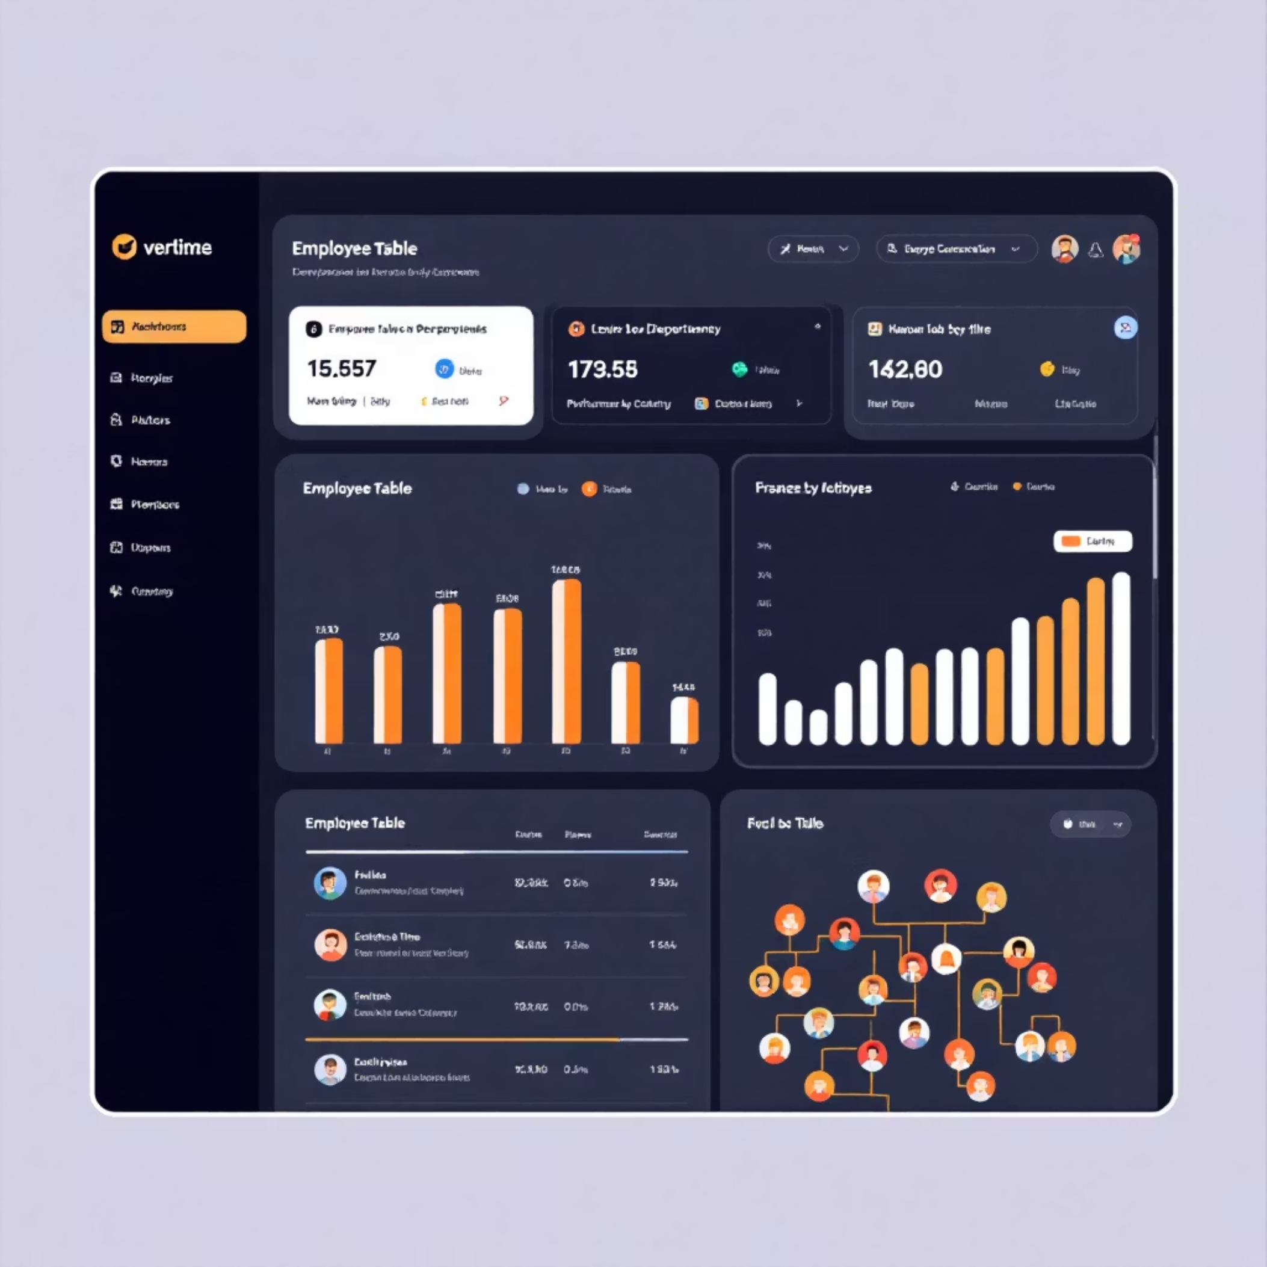
HR Insights: Employee Details & Performance
Detailed employee data and performance scores for informed HR decisions.
Interactive Table
Employee details: name, salary, bonus, experience, performance score.
Slicers for Filtration
Filter by country, department, contract type, and gender.
Visual Performance
Bar Chart: Performance Score by Department. TreeMap: Employees by Job Title.

Slide 10








Driving Strategic HR Decisions
The project's insights empower stakeholders to optimize HR and compensation strategies.
Data Collection
Analysis
Gathering comprehensive employee salary data.
Cleaning, querying, and visualizing data for insights.
Strategic Impact
Informed Decisions
Optimizing talent management and retention.
Guiding HR and compensation strategies.

